Slide 1


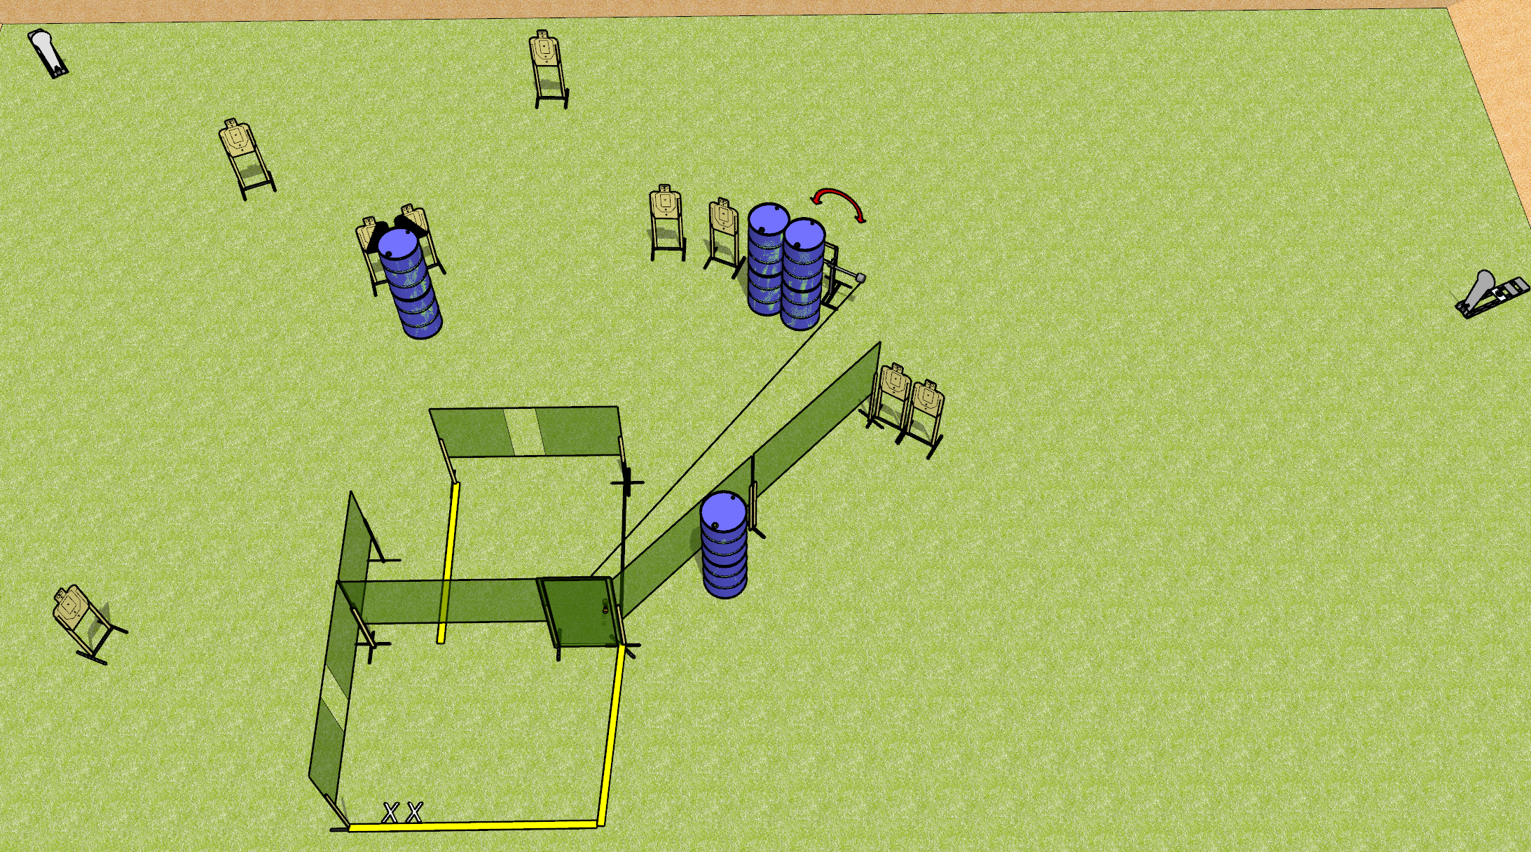
 | Dothan Gun Club – USPSA Match Out the Door Course Designer : Drew Coleman
Round Count 22 rounds 10 USPSA 2 colt poppers
Equipment List 11 wall feet Swinger + activator to door 1 left + 1 right diag, 8 targets

Slide 2
Out the Door
Written Stage Briefing
Out the Door is a 22 round, 110 point, Comstock course of fire. There are 10 USPSA targets and 2 colt poppers. The best 2 hits on paper will score, and steel must fall to score. The start signal is audible.
The swinger is activated by the door and remains visible at rest.
Handgun start position is feet on X’s, wrists above shoulders. Handgun is loaded and holstered.
PCC start position is feet on X’s, stock on belt. Loaded carbine is held with both hands, safety on.
On start signal, engage targets as they become available from within the shooting area.

